Slide 1
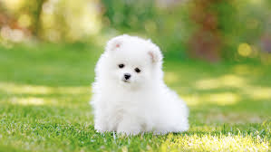
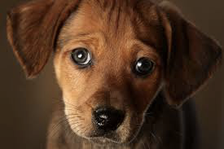
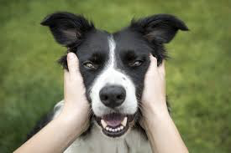
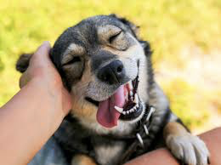
Dog-E-Date
An App For
Sophisticated Dog Lovers

Slide 2
Resource Links
Repos
https://github.com/know-mad/dog-e-date-web
https://github.com/know-mad/dog-e-date-mobile
https://github.com/know-mad/dog-e-date
Deployed Backend Resources
https://dog-e-date.herokuapp.com/dog
https://dog-e-date.herokuapp.com/user
Deployed Frontend Resources
dog-e-date.netlify.app

Slide 3
App Specs - The Dog is the Hero, the Owner is the Sidekick.
Core Functionality:
Display a picture of your dog. User “Likes” picture, if they want to connect and “Ignore”, if not.
ASKs are sent to OWNER’s ask QUEUE
If OWNER “Likes”, then we get a MATCH.
MATCH opens up the option to send messages.
App Description: “Like” to connect dog enthusiasts through their individual dog profiles.
Users:
Dog owner
Use Case: connect owners for play dates, breeding, etc. (we don’t ask)
Possible Scale Options: Dog buyers
Find a dog to adopt
Dog suppliers
Find a home for your dog/dogs
Models
User - location, dogs owned,
Dogs - location, parent, likes, breed, size, characteristics
Locations - dogparks
Likes, Notifications
*Messages
Notes:
Dog profile
Owner Profile
Dogs contains owners

Slide 4
Roles & Assignments
Project Lead: David Velez (Vee)
Architect: Chris Birkenhagen
Engineer: Castillo
Assistant TO the engineer: Connor

Slide 5
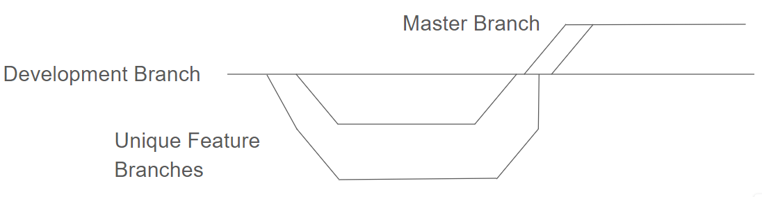
Git Workflow Guidelines: https://github.com/know-mad/dog-e-date
Git Setup:
Get added as collaborator.
Clone down repo
git clone repolink
Install dependencies
npm install
Run app on dev repo to check for errors/bugs
Git Issue Workflow:
Pull “dev” branch from Repo. git pull
Switch to a new feature branch. git checkout -b lastname-feature
Implement the feature, make sure it works locally.
Commits: What’s been added since last commit.
Naming convention: “feature-progress” ex. “Slider-bug fix in x component”
Do final commit for working feature: git commit -m “feature-complete”
Switch to “dev” branch and update dev from cloud: git checkout dev , git pull
Merge feature branch: git merge lastname-feature dev
Test feature on new dev branch for errors/bugs.
Push feature up to cloud: git push

Slide 6
Implementation Timeline:
Wednesday Targets:
Build out backend - 4 Models
Front end Wireframe
React-native development environment setup
React-native core-components review
Thursday Targets:
MVP - Core Functionality -
Slider Page: view dogs from location & ASKs, “Like”/”Dislike”
Profile Page: user CRUD, dog CRUD,
Message Dashboard: View MATCH’s
Friday Targets:
Sophisticated Styling
Message functionality

Slide 7
Back-end Planning
Tech Stack: Mongodb, express, mongoose
Collections:
User - location, dogs owned,
Dogs - location, parent, likes, breed, size, characteristics, likes
Locations - dogparks
Notifications - eventually messages

Slide 8
Backend Outline
Connection - first
Model - second
Controller - last
Router - fourth
Index - third

Slide 9
Front End Planning
Slider Page
Components:
Photo viewer
Tap to show next photo
Actions
Animation
(-) = “Dislike”
(+) = “Like”
ASK queue & location queue
User receives location based options, plus any ASKs they receive
Profile Page
Add user info, set password, etc., user photos, location
Add dogs
Photos
characteristics
Message Dashboard
MATCH list - a user’s contact list
Basic message functionality

Slide 10
React-Native Development Environment Setup
Mobile Application:
Swipe-right, Swipe-left capability

Slide 11
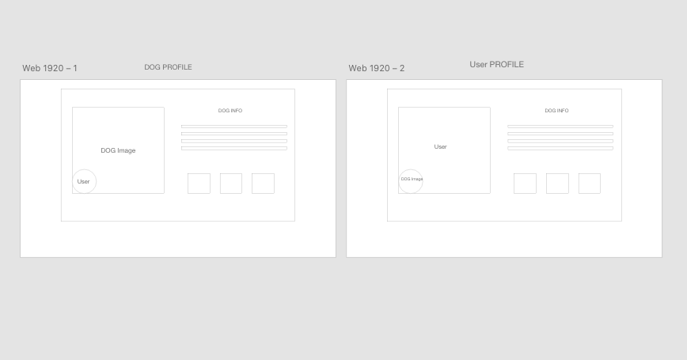
Front-end-web Wireframe -
Full Specs: https://docs.google.com/document/d/1znYrJddiaDz4PmJ0Q8yeDc9SZrjWDLNL_Tzeop4BYSA/edit
Index.js
States:
userLoginInfo : {username: “”, password: “”)
userObj:
userASKList
userMATCHList
dogList
currentLocation
Routes:
Login Page - Castillo
Create Account Page - Castillo
“Slider” Page - Chris
User Profile Page - Vee
Message-Dashboard Page - Connor

Slide 12
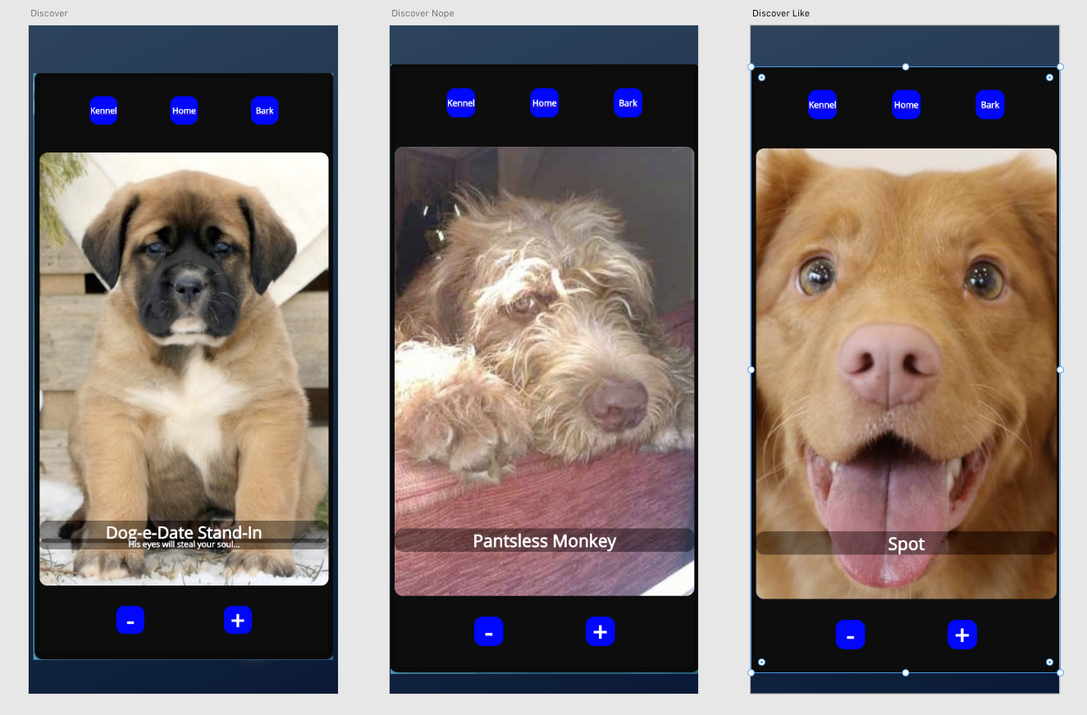
Dog Park
Props: dogs,
State:
dogListFeed - holds queue of dogs to view
currentDog
Methods:
getDogListFeed - fill the queue
handleIgnore - push userId into Dog.Ignores & get next photo
handleLikes - push userId into Dog.likes & get next photo
Output: attach likes/ignores to dogs

Slide 13
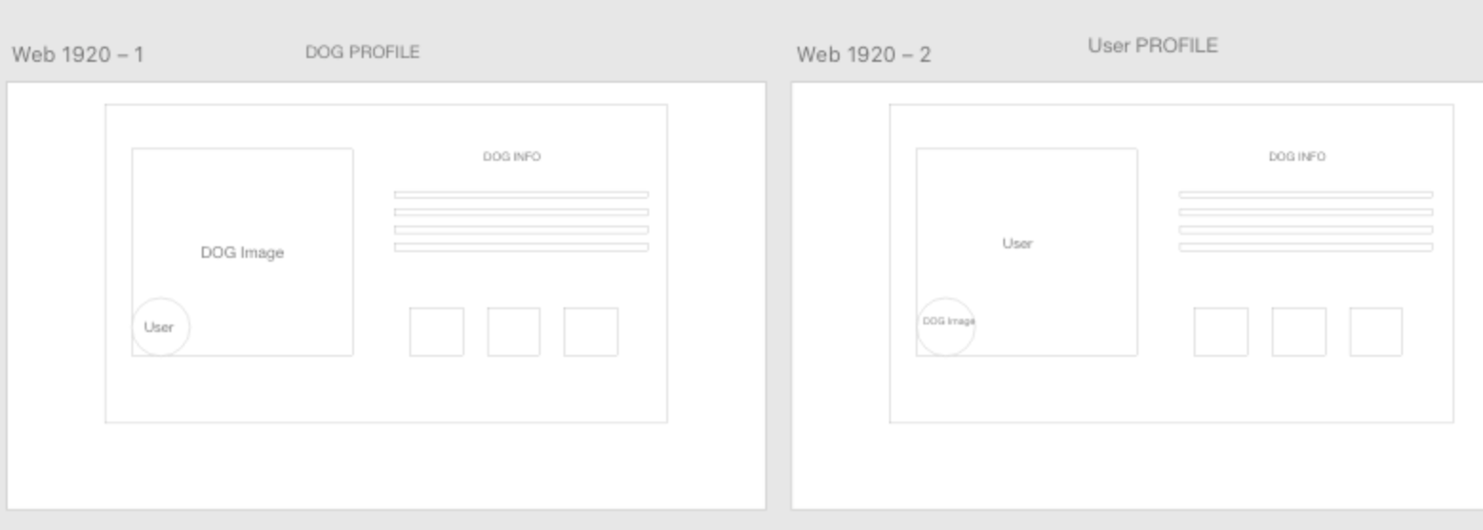
Kennel: userInfo, dogInfo

Slide 14
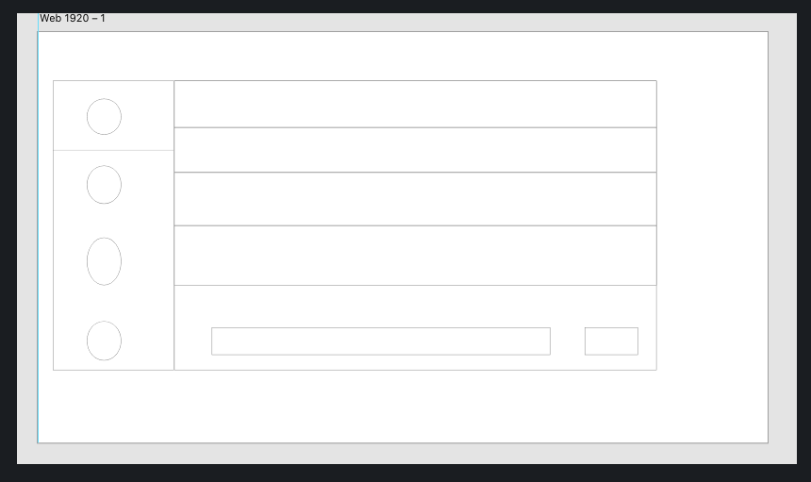
Barks Dashboard
Props:
userInfo
State:
Message data from API

Slide 15
Back end routes and models
All routes follow the same paths….
router.get('/dog', dogController.index)
router.get('/dog/:id', dogController.showDog)
router.post('/dog/', dogController.create)
router.put('/dog/:id', dogController.edit)
router.delete('/dog/:id', dogController.delete)

